Slide 1
CS 419: Production Rendering Noise-Based Textures
Eric Shaffer

Slide 2
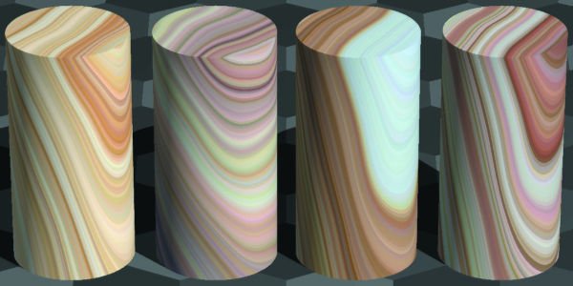
Objectives
Be able to compute and interpolate noise on a lattice
Use sums of lattice noises to construct
fractal sum, turbulence, and fractional Brownian motion
Be able to implement marble and sandstone

Slide 3
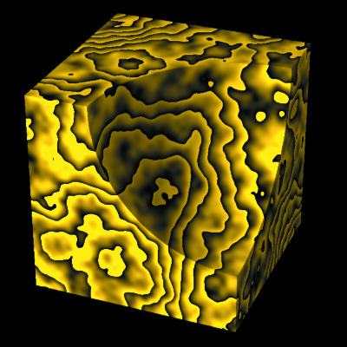
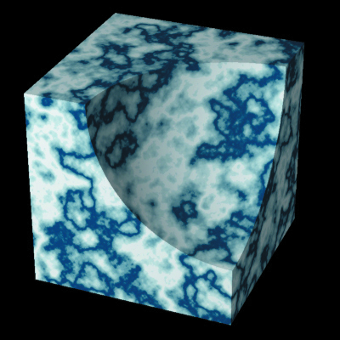
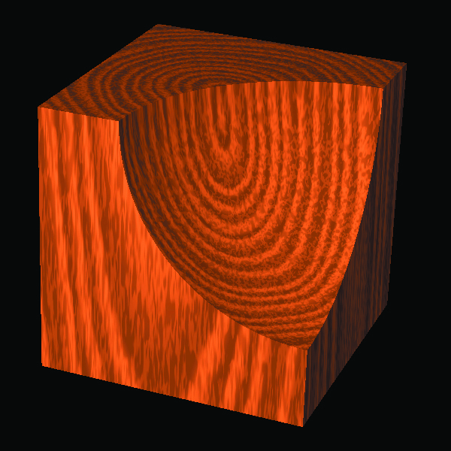
Noise-based Textures
Much like fractal modeling of geometry…
Noise-based textures model semi-random natural textures

Slide 4
Desirable Properties in Noise
Generated by repeatable pseudo-random function
Has a known range
Band-limited
Rate at which the function varies by position is limited
Not obviously periodic or regular
Stationary
Statistical properties invariant with position
Isotropic
Statistical properties same in all directions

Slide 5
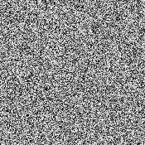
White Noise
What property doesn’t hold? Not actually clear in the book’s exposition… Just states that the “infinite” detail would result in aliasing

Slide 6
Lattice Noise Functions
Store pseudorandom number at integer coordinate positions
Use interpolation to generate values not on lattice points
Storing single values is scalar function…
Sufficient for generating colors in a texture
Could implement vector function
Why store vector values? What other effect could you generate?

Slide 7
Infinite Lattice
Given hit point (x,y,z) find integer coordinates (ix,iy,iz)
Just truncate
RTftGU uses a 256-value 1-dimensional array of function values
Hashes (ix,iy,iz) into the value array
Keep a permutation array PERM with values 0 through 255 randomized

Slide 8
Linear Interpolation

Slide 9
Bilinear Interpolation

Slide 10
Bilinear Interpolation

Slide 11
Trilinear Interpolation

Slide 12
Trilinear Interpolation

Slide 13
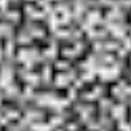
Examples

Slide 14
Cubic Interpolation
Catmull-Rom Splines
Cubic splines will interpolate 4 values (the control points)
Determines the coefficients in ax³ + bx² + cx + d
To find n(x), need 4 function values (2 on each side)
Resulting composite function is C1 continuous
It is not C2 continuous.
Curve may lie outside bounding box of control points

Slide 15
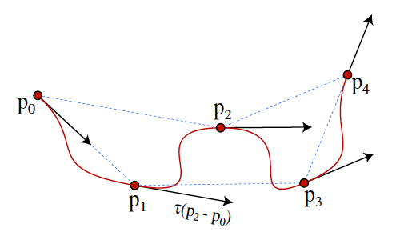
Cubic Catmull-Rom Spline
Tangent at each point determined by two surrounding points
At end points use p_{i} – p_{i-1}

Slide 16
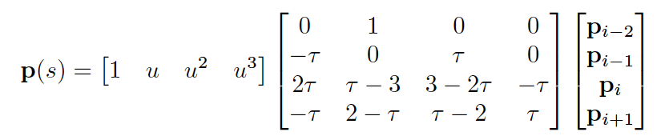
Cubic Catmull-Rom Spline
Here u is where we are evaluating the function value
We’ll take τ= 0.5
For a 1D domain, the p_{i} values will just be the prn function values of the lattice

Slide 17
Cubic Catmull-Rom Spline
Why might we want to return a vector?
What would the parameter u be in this case?

Slide 18
Bicubic Interpolation

Slide 19
Bicubic Interpolation

Slide 20
Tricubic Interpolation

Slide 21
Tricubic Interpolation

Slide 22
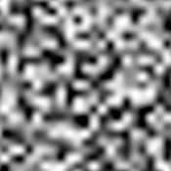
Examples

Slide 23
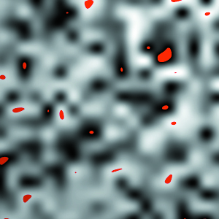
Overshooting
Imagine a random noise function should produce values in [-1,1]
Catmull-Rom spline can report interpolated values outside that range
So…you need to clamp the values to the range [-1,1]

Slide 24
Altering Noise Functions
Can alter the functions by summing them
Use different amplitudes and frequencies
Spatial frequency describes how quickly function varies with position
Band-limited → finite max spatial frequency

Slide 25
Fractal Sum
Create a new function summing shifted noise functions

Slide 26
Fractal Sum
Create a new function summing shifted noise functions
Each successive term has
half the amplitude
twice the spatial frequency
Terms that differ by a factor of 2 are called octaves
Can scale value to lie in [0,1]

Slide 27



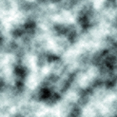
Example

Slide 28
Turbulence
Turbulence (Perlin 85) is similar to fractal sum
But it uses the absolute value of the noise function

Slide 29


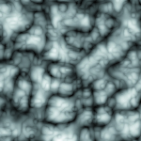
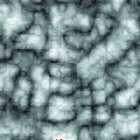
Turbulence

Slide 30
Fractional Brownian Motion (fBm)
fBm generalizes fractal sum
amplitudes change according a to ratio (gain)
spatial frequencies change according to a ratio (lacunarity)
What about when gain=1?
What do we get with gain=0.5 and lacunarity=2?

Slide 31
fBM Varying Gain
0.25 1.0

Slide 32

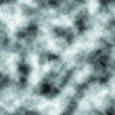
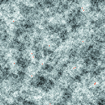
fBM Varying Gain

Slide 33

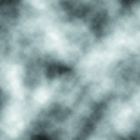
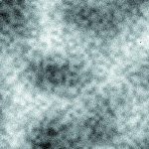
fBm Varying Lacunarity

Slide 34

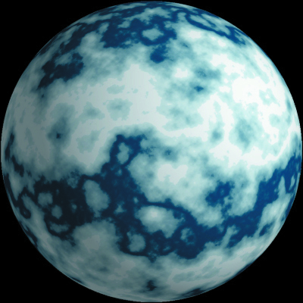
Marble
We will use a ramp to select a marble color
…but we need to add some noise first

Slide 35

Marble Examples

Slide 36

Sandstone

